Slide 1
Group- 5
Presenting
Resume Classification
Presented By:
Ms. Shweta Dubey
Ms. Sahana Jagadish Ganiger
Mr. Harsh Jatav
Mr. Arakala Dinesh
Mr. Jyoti Prakash Brahma
Mr. Veera Veesam

Slide 2
Business Objective :
The document classification solution should significantly reduce the manual human effort in the HRM
It should achieve a higher level of accuracy and automation with minimal human intervention.
To make case of selection resumes for recruiter without actually going through each of them.
To help candidates to find and apply the most suitable job roles form the job.

Slide 3
Project Architecture :
Collection Of Data
Business Understanding
EDA
Deployment
Model
Finalizing
Model Selection

Slide 4
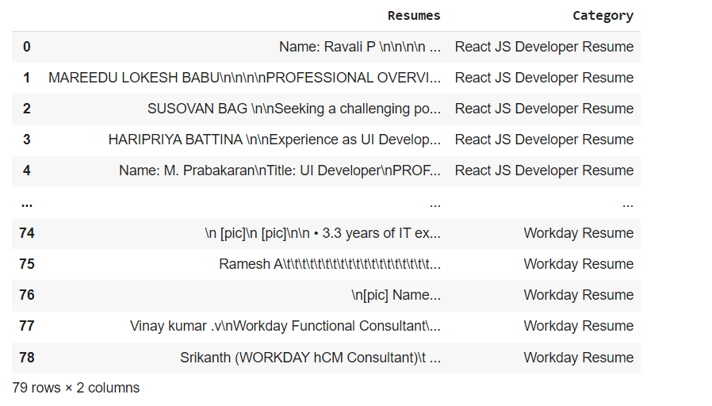
Dataset Details :
After Extracting and Modifying the Dataset, given data contains a total of 4 Classes, 2 features and 79 rows.

Slide 5
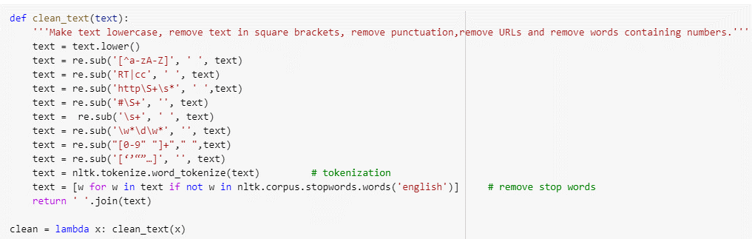
EDA :
Removing all Unwanted Characters- \n \t, http links, tags, hashtags, html tags, converting to lower case, removing white spaces etc.
Word Tokenization - Tokenization is essentially splitting a phrase, sentence, paragraph, or an entire text document into smaller units, such as individual words or terms. Each of these smaller units are called tokens.
Removing Stop-words - A stop word is a commonly used word (such as “the”, “a”, “an”, “in”) that a search engine has been programmed to ignore, both when indexing entries for searching and when retrieving them as the result of a search query.

Slide 6
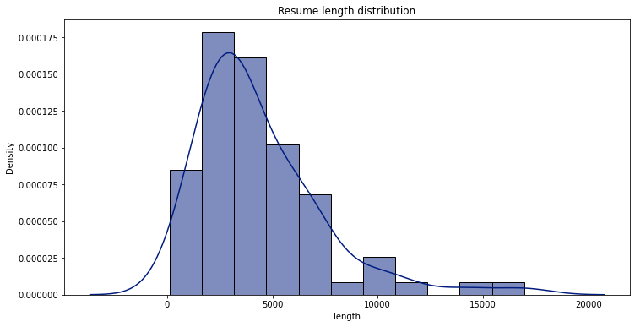
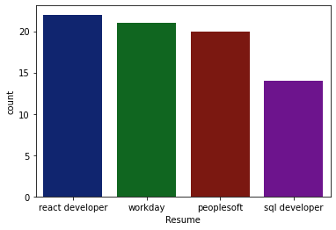
Visualization of Data :
By using Bar plot role applied feature is displayed to check the job types.
This shows the Resume length Distribution

Slide 7
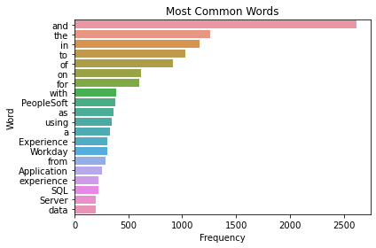
Word Frequencies in Resumes
In this graph the frequency of Words in Resumes are show, there is most of the words are highly used in the dataset like Workday, Experience, experience, peoplesoft .etc

Slide 8
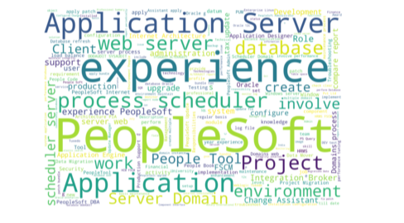
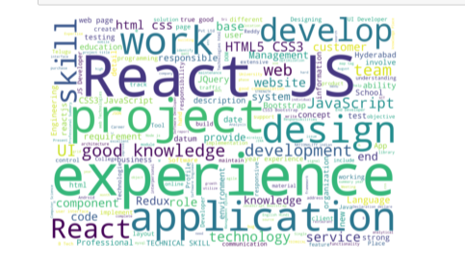
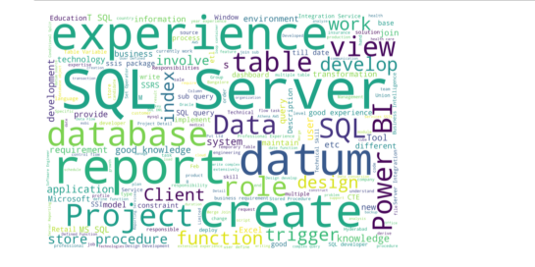
WordCloud

Slide 9

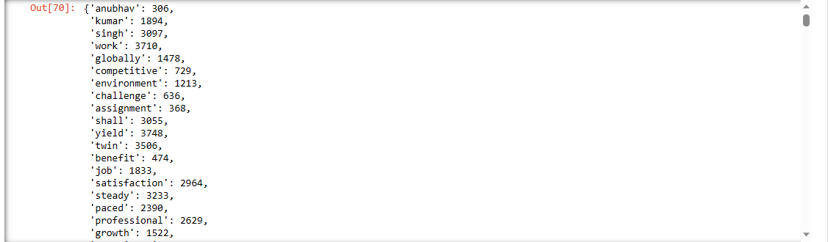
Bag of Words :
A bag-of-words is a representation of text that describes the occurrence of words within a document. It involves two things: A vocabulary of known words. A measure of the presence of known words

Slide 10
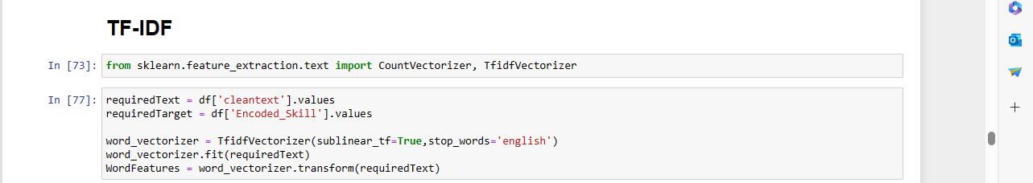
TFIDF - Term frequency inverse Document Frequency :
TF-IDF is better than Count Vectorizers because it not only focuses on the frequency of words present in the corpus but also provides the importance of the words.
We can then remove the words that are less important for analysis, hence making the model building less complex by reducing the input dimensions.

Slide 11
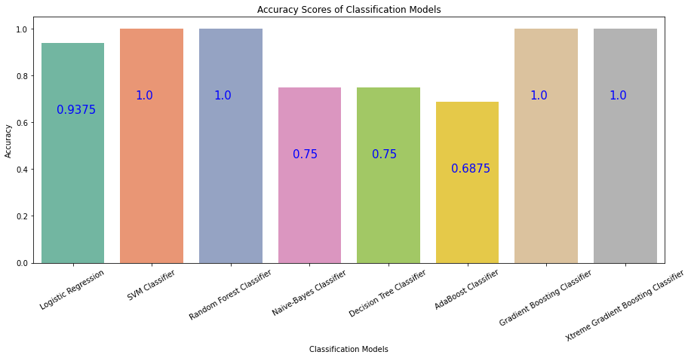
Accuracy Score :
We have trained and tested each model and recorded the resultant accuracy. Below graph shows the accuracy of each classifier.

Slide 12
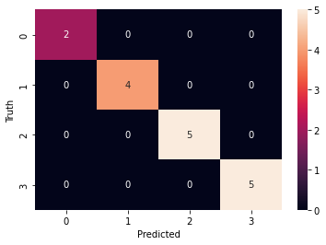
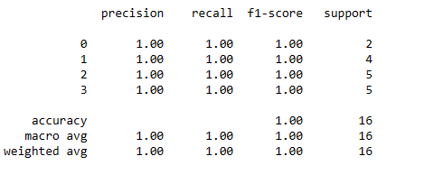
Finalizing Model :
From the accuracy , precision, recall,F1_score comparison, we got 100% result for random forest classifier.

Slide 13
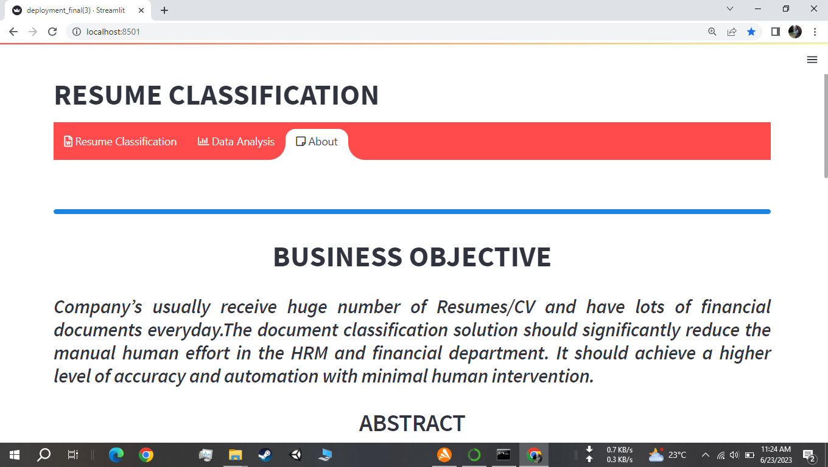
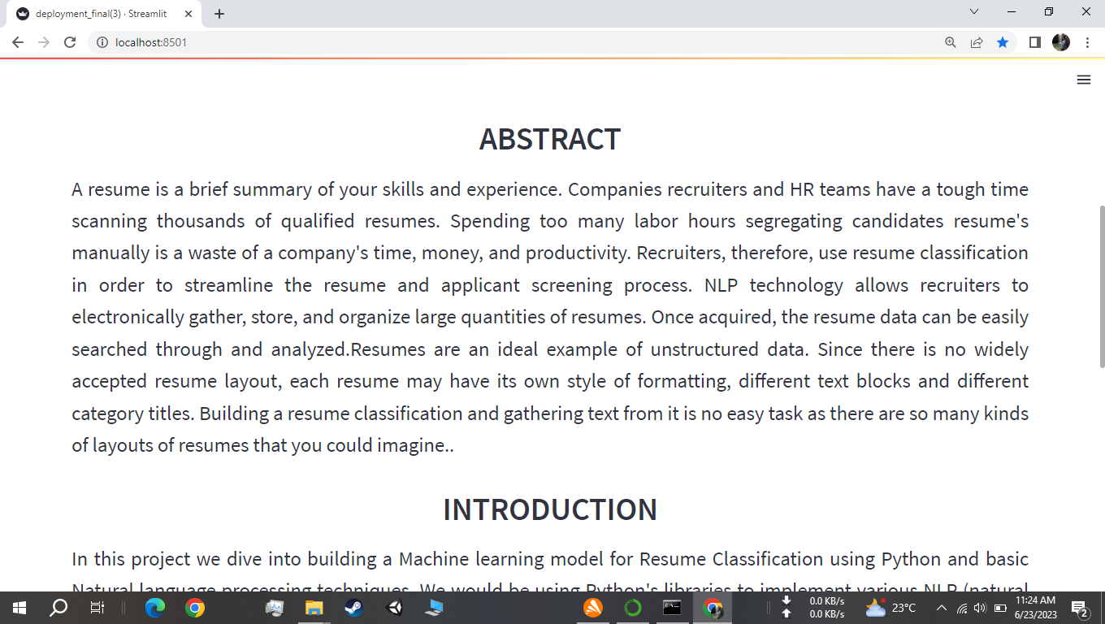
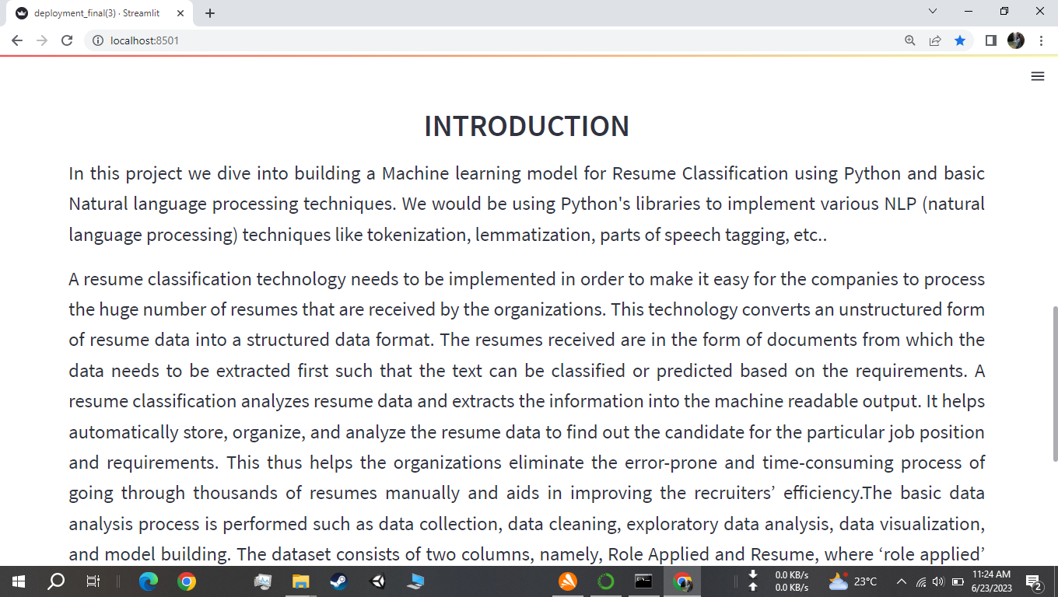
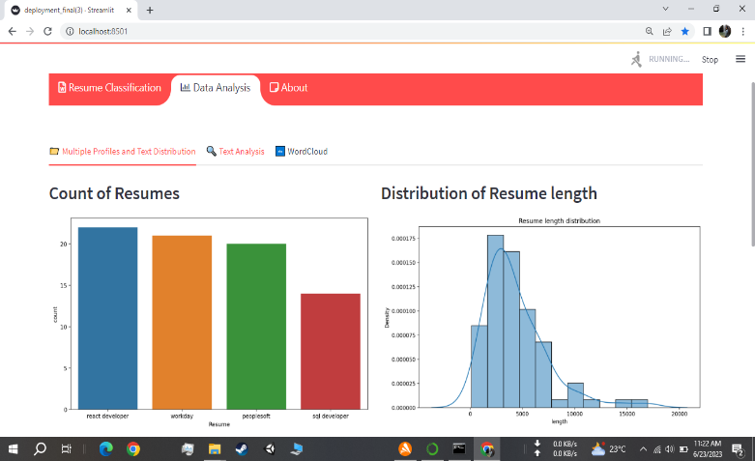
Deployment :
After model building and Evaluation process, We have deployed the code using “ Streamlit ”.
We have selected the best model RANDOM FOREST CLASSIFIER and used in our deployment phase

Slide 14


